Slide 1
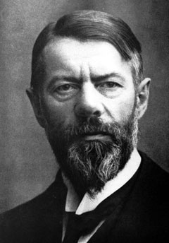
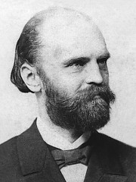
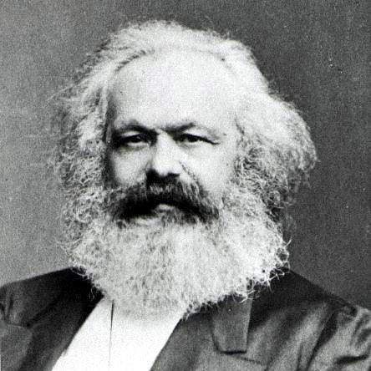
TÖNNIES, WEBER & MARX

Slide 2
SOCIOLOGY IN GERMANY
So far we examined a history of the evolution of Sociology as a discipline.
We saw that Sociology emerged in Europe, more specifically in France, with the likes of Comte & Durkheim.
In Germany, the discipline was introduced by Ferdinand Tönnies and Max Weber.

Slide 3
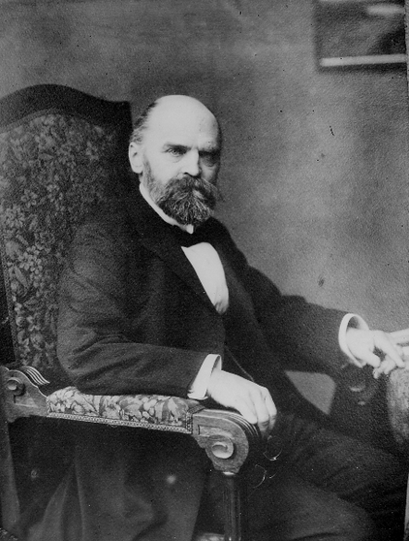
FERDINAND TÖNNIES (1855-1936)
Contributions to Sociology:
Gemeinschaft & Gesellschaft published in Gemeinschaft und Gesellschaft (1887)

Slide 4
GEMEINSCHAFT & GESELLSCHAFT
Like Durkheim, Tönnies compared pre-modern (simple) and modern (complex) societies to see how they differed.
His difference to Durkheim’s theories was that he attempted to understand how social relationships between people differed in two types of society.
He tried to examine what were the sources of social change.

Slide 5
His comparison of agrarian and industrial societies led Tönnies to conclude that there are two basic categories of social relationships .
The first category is made up of those social relationships that people enter into as ends in and of themselves (gemeinschaft).
The second category includes social relationships that people enter into as means to specific ends (gesellschaft).

Slide 6
Gemeinschaft & Gesellchaft were two types of social relationships found in groups.
People into relationships that are ends in and of themselves for emotional or affective reasons.
An individual’s relationship with his or her family is an example of this type of relationship.
Tönnies called this type of emotion-based relationships: Gemeinschaft or personal (communal) relationships.

Slide 7
People enter into relationships that are a means to an end, not out of affective or natural affinity, but to achieve some specific goal (for example, financial gain).
Tönnies called these goal-driven relationships, Gesellschaft or impersonal social relationships.
For example, your relationship with your boss is described as a Gesellschaft relationship.

Slide 8
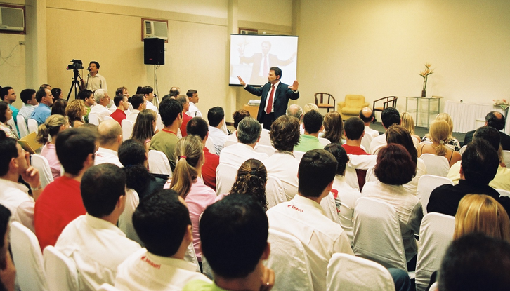
TYPE OF RELATIONSHIP | ASSOCIATION
GEMEINSCHAFT | PERSONAL
GESELLSCHAFT | IMPERSONAL

Slide 9
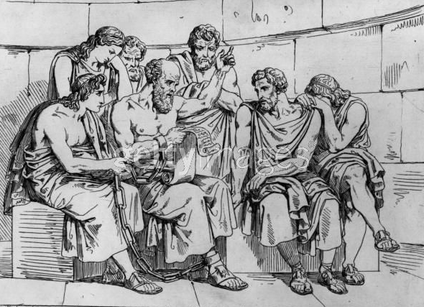
According to Tönnies, the main difference between the two societies is the proportions that exist in the relationships.
For example, in the past there were less people in the academic sphere, therefore relationships to professors were more personal when compared to modern society.

Slide 10
Tönnies major contribution to the study of Sociology was the suggestion that if we wish to understand social life, we have to understand that people enter into relationships for different reasons and these reasons determine the nature of the relationship and how we treat those people.
Therefore, the type of the relationship determines the rules of the relationship.

Slide 11
Tönnies believed that other than personal social relationships, the society could also be classified as being predominantly Gemeinschaft or Gesellschaft.

Slide 12
Therefore:
Gemeinschaft predominantly occurs in a PRE-MODERN, SIMPLE OR AGRARIAN SOCIETY
Gesellschaft would more likely occur in a MODERN, COMPLEX OR INDUSTRIAL SOCIETY.

Slide 13
EXERCISE
Determine which of the following types of relationships are more likely to be GEMEINSCHAFT or GESELLCHAFT:
RELATIONSHIP | GEMEINSCHAFT | GESELLSCHAFT
FRIEND/FRIEND
WIFE/HUSBAND
DOCTOR/PATIENT
RETAILER/CUSTOMER
MINISTER/PARISHIONER
PARENT/CHILD
WORKER/BOSS
LECTURER/STUDENT
PRIMARY SCHOOL TEACHER/PUPIL
CO-WORKER/CO-WORKER

Slide 14
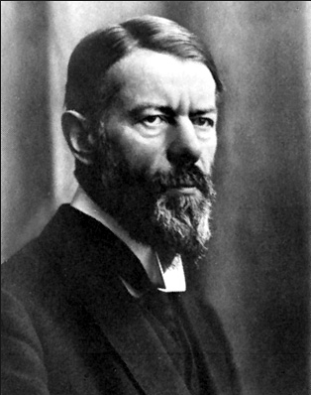
MAX WEBER (1864-1920)
Contributions to Sociology:
Social Action Theory (Micro)
Verstehen
Rationality
Bureaucracy
Authority
The Protestant Ethic & the
Spirit of Capitalism

Slide 15
SOCIAL ACTION THEORY
Weber is the founding father of the Social Action theory.
This is also known as the “Micro” or interpretive perspective.
In this view, individuals are considered powerful social actors who control their destiny.
These theorists believe that the individual determines and shapes behaviour and what the institutions.
Society is a product of human actions.
Individual → Institutions & Structures

Slide 16
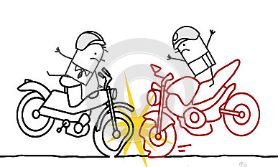
Weber defined a ‘social action’ as an action carried out by an individual to which an individual attached a meaning.
For example, an accident on a bike is a not a social action because it happened unintentionally, but a person cutting down a tree is or lighting a candle.

Slide 17
VERSTEHEN
Taking the micro perspective into account, Weber came up with the notion of verstehen.
Weber suggested that everyone should apply verstehen (understanding) when examining people’s actions and behaviours.
The whole idea of verstehen is to put yourself in the other person’s shoes when trying to explain why an action was committed.

Slide 18
RATIONALITY
Weber was intrigued with Tonnies view that people act with a variety of motives.
Weber compared Traditional & Modern societies and advocated that people became more rational as the society became more modern.
Weber defined rational as calculating and logically deciding upon something.
The opposite for rational was “non-rational” or non-calculating.

Slide 19
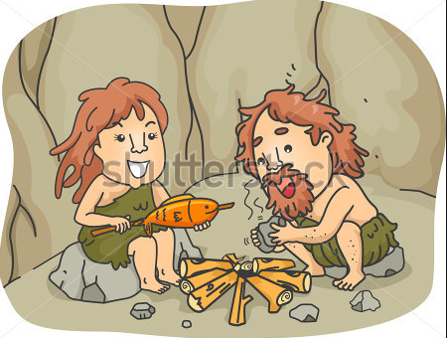
In pre-modern societies, people were more likely to engage in non-rational behaviour.
They were less calculating and less concerned about achieving larger ends.
People did things simply because they enjoyed them.
For e.g. – when a pre-modern person had enough food to eat and were living comfortable, they were content and stopped working.

Slide 20
In a modern society, people are considered more rational.
People tend to choose efficiency over fun.
They are more robot-like and tend to ignore emotions & feelings over rationality.
They would logically decide on the pros & cons of doing something.
For example, attending a university to attain a high-end job (according to Weber) is a rational decision.
A non-rational decision is to attend university because the student just feels to learn.

Slide 21
BUREAUCRACY
Weber believed that Bureaucracies are a common feature in modern societies because individuals are more rational in Capitalist Industrial societies.
Bureaucracies exist at a large scale and a small scale.
It is a system with a complex set of rules and procedures, separate functions and a hierarchical of individuals determining authority.

Slide 22
Bureaucracies are well known in government offices but they also exist in all institutions including the family, religious, government, legal & educational institutions.

Slide 23
AUTHORITY
Weber (1957) identified three (3) types of authority:
RATIONAL-LEGAL
TRADITIONAL
CHARISMATIC

Slide 24
RATIONAL-LEGAL:
Power is vested in individuals (offices) to uphold rights and implement rules & procedures impersonally.
These rulers gain power & authority through legitimate procedures (elected by the people) and hold power as long as they obey the laws that legitimize their rule.
E.g. – Barack Obama or Kamla Persad-Bissessar

Slide 25
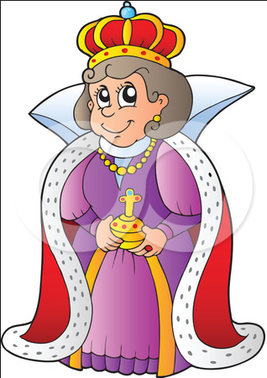
TRADITIONAL:
the customs of the past legitimize the present. Things are always as they have been and should remain the same. Authority is (usually) hereditary, although it may not always be the case. But authority is accepted as legitimate by those being ruled.
E.g. – Queen of England, Sultans or Emperors

Slide 26
CHARISMATIC:
derives from a ruler’s ability to inspire passion and devotion among followers. A charismatic leader, who usually emerges during a period of crisis, is able to capture the attention of his supporters. Charismatic rulers emerge when people lose faith in social institutions.

Slide 27
Followers would:
Perceive the leader is supernatural
Blindly believe the leader’s statements
Unconditionally comply with the leader’s directives
Give the leader unqualified emotional commitment
E.g. – Adolph Hitler, Vladimir Lenin, Fidel Castro, Toussaint L’Ouverture, Ché Guevara, Haile Selassie, Sadaam Hussein, Osama Bin Laden, Barack Obama, John F. Kennedy, Martin Luther King Jr., Mahatma Gandhi, Nelson Mandela Eric Williams, Basdeo Panday, Abu Bakr, Jesus Christ.

Slide 28
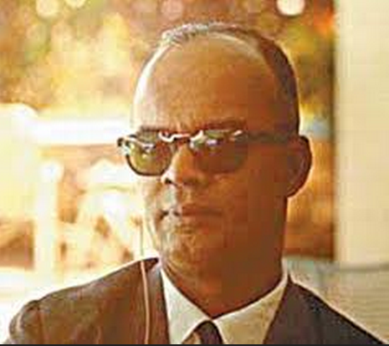
It is important to recognize that types of authority overlap and an individual can be described as possessing more than one types of authority. For example, Williams was both Rational-Legal and Charismatic.

Slide 29
THE PROTESTANT ETHIC & THE SPIRIT OF CAPITALISM (1904)
The Reformation is a time when people questioned the validity of the Roman Catholic Church. It occurred in the 1500s.
The Protestants included the Anglicans, Presbyterians, Pentecostals, Baptists, Moravians & Calvinists.
Capitalism – is a period where there is competition, privatization of businesses, and profit-centred.

Slide 30
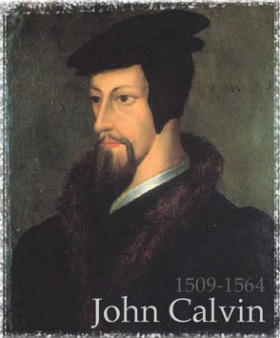
In order to prove to the Macro theorists that individuals could actually influence and shape the institutions, Weber examined the impact the Calvinists had on the creation of Capitalism.

Slide 31
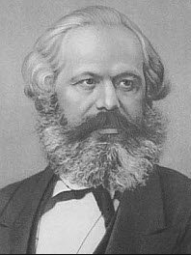
KARL MARX (1818-1883)
Contributions to Sociology:
Economic Determinism
Conflict theory
The Communist Manifesto
Dialectic Materialism
Capitalism – Bourgeoisie & Proletariat
Superstructure & Economic- Based Infrastructure
False-Class Consciousness
Communism

Slide 32
KARL MARX
Many sociologists rank the German, Karl Marx, among the most critical founding fathers of Sociology.
Curiously, Karl Marx never considered himself a sociologist.
He saw himself as a philosopher, historian, economist and even political scientist.
He disliked the idea that sociologists would focus on the social factors that influence phenomena.
For Marx, the most influential factor was economic.

Slide 33
ECONOMIC DETERMINISM
Karl Marx believed that economics (wealth, money, demand and supply) are the driving forces of society.
For him, it is money and wealth that influences what the institutions look like and how individuals behave (which are the main points of investigation in Sociology).
He also advocates that it is the economy that shapes the nature of the society; hence the reason for wars and why governments fall and new ones are established.
Many of his critics have accused him of being too economically deterministic.

Slide 34
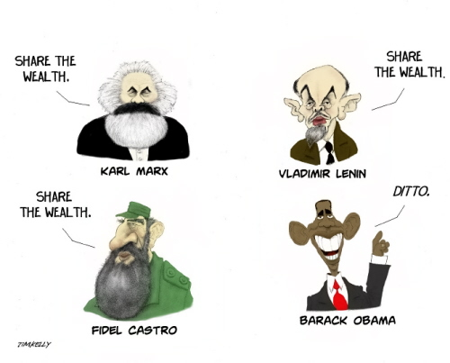

Slide 35
CONFLICT THEORY
Although he did not see himself as a Sociologist, Karl Marx is the founding father of the Conflict Theory (Marxism).
Like the Functionalists, conflict theory is a structural or Macro- sociological perspective.
However, this is their ONLY similarity.
Marxism offers a radical or revolutionary alternative to Functionalism.

Slide 36
Their MAIN tenet is that society is in a perpetual state of conflict because there are different groups with different needs and interests.
According to Tischler (2007, 21), conflict theorists view society as constantly changing in response to social inequality and social conflict.

Slide 37
THE COMMUNIST MANIFESTO (1848)
Karl Marx’s most famous writing is The Communist Manifesto (1848) which he wrote with co-author & philosopher Friedrich Engels.
Till today it is seen as one of the world’s most influential political manuscripts.
Marx argues that groups in society clash because of injustice, inequality, exploitation and subjugation of the less powerful groups.
Although conflict produces inequality, it is desirable as it brings about social change such as a classless communist society.

Slide 38
DIALECTIC MATERIALISM
Conflict is normal and desirable.
Social equilibrium or order is the dominant or ruling class ploy of maintaining control
According to Marxists, there are two groups in contemporary Capitalist society:
Ruling Class (BOURGEOISIE or Capitalists)
Lower/Subordinate Class (PROLETARIAT or Working class)
Dialectic Materialism is the clash of two groups for material possessions (wealth).
Marx argues that this conflict is natural because they have differing interests.

Slide 39
CAPITALISM
In 1857, Marx wrote his 800 page manuscript - Das Kapital.
In Marx’s capitalist society, there are two opposing & polarizing classes.
These class positions are determined economically, through the Means of Production (land, capital, technology & labour).
The ruling class own all means of production but labour.

Slide 40
SUPERSTRUCTURE & INFRASTRUCTURE
Superstructure – Institutions
Infrastructure – Economy
For Marx, the infrastructure always influences the superstructure.
Therefore, whoever controlled the wealth or infrastructure of any society, they would also determine what the superstructure looked like.

Slide 41
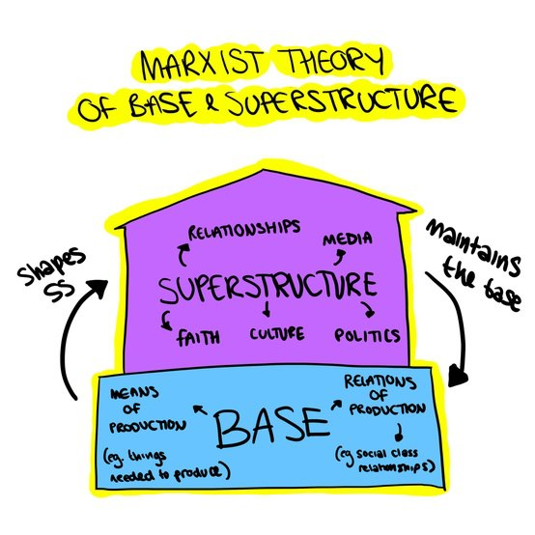

Slide 42
FALSE-CLASS CONSCIOUSNESS
In order to maintain control, the ruling class promotes a false-class consciousness and alienation through the institutions – religion, education, family.
False-class consciousness meant that the entire working or lower class would be fooled into believing that all is right with their situation and suffering and they would continue to quietly work and benefit the ruling class.

Slide 43
Marx called religion: “the opium of the masses.”
He posited that religion was the most powerful means of promoting a false-class consciousness because it was able to control the minds of the populace into believing that their suffering on earth was derived by God and not man.
Marx articulated that education, governments, the legal system and even the family also promoted a false-class conscious which would hide the inequalities of the economic realities.

Slide 44
MARXISM

Slide 45
HISTORICAL DIALECTIC
Evolution of Society (Marx):
Primitive Communism – classless
Asiatic Groups – tyrants vs masses (EAST)
Ancient Society – slave masters vs slaves (WEST)
Feudal Society – landlords vs serfs
Capitalist Society – Bourgeoisie vs Proletariat
Socialist Society – Dictatorship of the Proletariat vs Former Elites
Communist Society – classless

Slide 47
COMMUNISM
Communist society – For Karl Marx, the only answer to all of society’s problems was the creation of a communist society.
He advocated that Communism was an equal, classless, utopian & ideal society where all the resources would be shared equally and everyone could co-exist peacefully and in harmony.
Till this day, there have never been any countries that have created a Communist society.

Slide 48
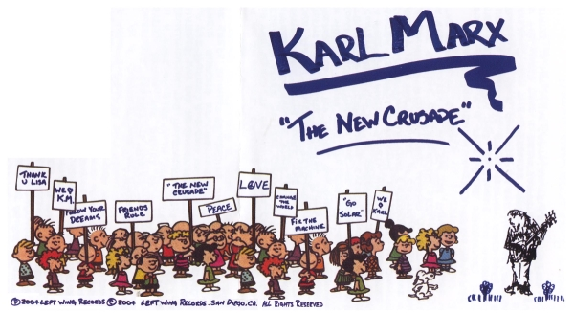

Slide 49
CRITIQUE:
One of Marx’s biggest critics was Max Weber.
He argued that Marx was too economically deterministic and he believed that there were many factors, other than the economy that affected the society.
He also argued that there were more than two polarizing classes and advocated the importance of a growing middle class.
Many people also deemed Marx an idealist and felt that his theories were not fulfilled as communism lost the drive it had following the Cold War.

Slide 50
IS MARXISM STILL RELEVANT?

Slide 51
BIBLIOGRAPHY
Boundless. “From Gemeinschaft to Gesellschaft.” Accessed 15 February 2014. https://www.boundless.com/sociology/social-change/sources-of-social-change/from-gemeinschaft-to-gesellschaft/
Haralambos, M. & Holborn, M. 2000. Sociology: Themes and Perspectives. 5th Ed. London: Harper Collins.
McIntyre, Lisa. 2006. The Practical Skeptic: Core Concepts in Sociology. 3rd Ed. New York, NY: Mc Graw Hill.
Tischler, Henry. 2007. Introduction to Sociology. 9th Edition. Belmont, CA, USA: Cengage Learning.

